Slide 1
RAJALAKSHMI ENGINEERING COLLEGE (AUTONOMOUS) | DEPARTMENT OF CSE
FOUNDATIONS OF ARTIFICIAL INTELLIGENCE • PROJECT REVIEW PRESENTATION
TEAMFORGE: Intelligent Student Team Formation Platform
Using Constraint Satisfaction and Heuristic Local Search
PROJECT CANDIDATES:
• TARUN ANTONY M (Reg No: 2116240701556)
• THANIKAIVEL S (Reg No: 2116240701562)
Degree: B.E. Computer Science and Engineering
PROJECT SUPERVISOR & INSTITUTION:
Mrs. B. Deepa, M.E., (Ph.D.)
Assistant Professor (Selection Grade), Dept. of CSE
Rajalakshmi Engineering College, Thandalam, Chennai
Academic Year: 2026–2027 | Review Date: November 2026

Slide 2
PROJECT CONTEXT
1. Background & Motivation: Why TeamForge?
High-Stakes Events
• Collegiate Hackathons (Smart India Hackathon, internal college hackathons) require multi-disciplinary skills within 24-36 hrs.
• Final Year Capstone Projects dictate graduation outcomes and project quality.
• Diverse skill sets needed: UI/UX, Backend, Database, AI/ML, Testing.
• Poorly structured teams lead to project abandonment or failure.
The Breakdown of Ad-Hoc Teams
• Social Clique Bias: Friends group together regardless of overlapping or missing technical competencies.
• Severe Skill Gaps: Teams with 4 frontend designers and zero database engineers, or vice versa.
• Schedule Bottlenecks: Uncoordinated commitments lead to inactive contributors.
• Isolated Solitary Talent: Introverted students or juniors with niche skills are systematically excluded.
The Classical AI Solution
• Replaces guesswork with mathematically optimal Constraint Satisfaction Problem (CSP).
• Pure Classical AI: Zero external black-box models, zero paid AI APIs, zero hallucinations.
• 100% Deterministic & Explainable audit trail for faculty and student leaders.
• Integrated Collaborative Workspace: Kanban board, sessions, and zero-retention ephemeral chat.
Rajalakshmi Engineering College | Dept. of Computer Science & Engineering | Project Review 2026 — Slide 2 of 19

Slide 3
PROBLEM DEFINITION
2. Problem Statement & Mathematical Formulation
The Core Problem Statement
Given a cohort of N registered college students possessing heterogeneous technical skill proficiencies, academic seniority levels, and availability schedules:
• Objective: Construct an optimal partition of students into cohesive project teams of target size K.
• Hard Feasibility: Every team must satisfy strict capacity limits, pairwise member uniqueness, and collegiate event registration.
• Multi-Objective Balance: Must balance technical skill coverage, role specialization, senior-junior pairing, and sprint availability.
• Explainability Requirement: System must provide an explainable decision log justifying candidate selection.
The Combinatorial Explosion Challenge
• The number of possible team combinations across N candidates for team size K follows the binomial coefficient:
C(N, K) = N! / [ K! * (N - K)! ]
• For a typical collegiate cohort (N = 60 students, K = 4 members):
C(60, 4) = 487,635 possible subsets per team!
• For K = 6 members:
C(60, 6) = 50,063,860 possible subsets!
• Brute-Force Exhaustive Enumeration is NP-hard and computationally prohibitive for interactive web applications.
• Requires Classical AI Search Heuristics (MRV + Forward Checking + Hill Climbing) to prune the search space to sub-millisecond execution.
Rajalakshmi Engineering College | Dept. of Computer Science & Engineering | Project Review 2026 — Slide 3 of 19

Slide 4
PROJECT OBJECTIVES
3. Key Objectives & Engineering Deliverables
Objective 1: Classical CSP Modeling
Formalize student team formation as a discrete Constraint Satisfaction Problem (CSP) with explicit Variables, Domains, and Hard Constraints.
Objective 2: Intelligent Search Space Pruning
Implement Backtracking Search augmented by Minimum Remaining Values (MRV) heuristic and Forward Checking (FC) to eliminate dead branches.
Objective 3: Heuristic Multi-Objective Local Search
Develop a Hill Climbing local search procedure with 1-opt candidate swaps guided by a 5-factor multi-objective scoring function.
Objective 4: Explainable Multi-Proposal Generator
Generate 3 distinct team proposals (Balanced Alpha, Skill-Dense Beta, Agile Gamma) with transparent step-by-step decision trace logs.
Objective 5: Full-Stack Web Architecture & Privacy
Engineer a high-throughput, decoupled platform (PHP 8.2 + MySQL 8.0) featuring Kanban boards, standups, and zero-storage ephemeral chat.
Rajalakshmi Engineering College | Dept. of Computer Science & Engineering | Project Review 2026 — Slide 4 of 19

Slide 5
STATE OF THE ART
4. Literature Review & Research Gaps
Platform / Approach | Matching Paradigm | Constraint Guarantees | AI Explainability | Data Privacy & Chat
Devpost / Hackathon Portals | Manual bulletin board / Self-selection | None (Manual checking) | Zero AI | External Discord/Slack links
Commercial HR AI Tools | Opaque Deep Learning / Embeddings | Probabilistic / Weak | Black-box (Unexplainable) | Permanent Cloud Data Retention
Academic CLI Scripts | Stand-alone scripts (ILP / GA) | Strict (Math formulations) | High (Mathematical rules) | No integrated communication
TeamForge (Proposed) | Hybrid CSP (MRV+FC) + Hill Climbing | 100% Deterministic & Hard | Full Step-by-Step Trace Log | Zero-Retention Ephemeral Buffer
Identified Research Gap Addressed by TeamForge
• Current academic tools lack end-to-end integration: they produce matching outputs in offline CSV files without project boards, session scheduling, or privacy-first communication.
• TeamForge bridges classical AI rigor (CSP + Local Search) directly into a production-grade collegiate web platform.
Rajalakshmi Engineering College | Dept. of Computer Science & Engineering | Project Review 2026 — Slide 5 of 19

Slide 6
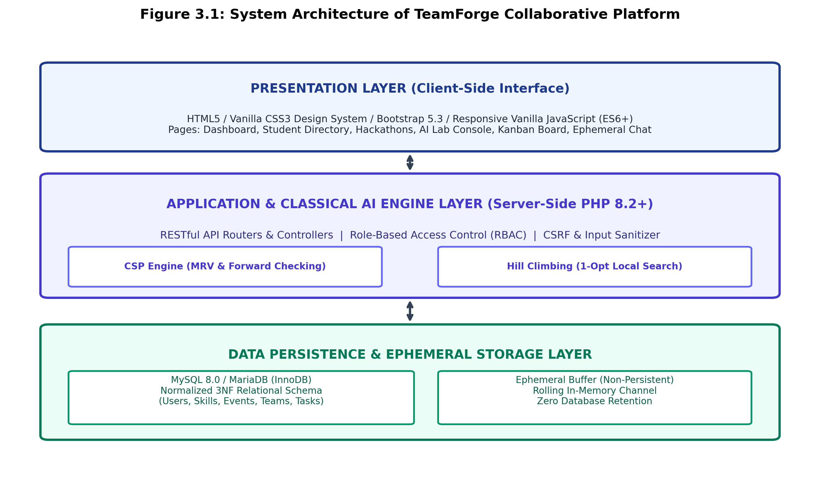
SYSTEM DESIGN
5. Proposed System Architecture: Decoupled Multi-Tier
Architectural Highlights
1. Presentation Layer (Client):
• Standards-compliant HTML5, Vanilla CSS3 Design Tokens, Bootstrap 5.3, ES6+ JS.
• Communicates strictly via asynchronous JSON fetch APIs.
2. Application & AI Engine Layer (Server):
• Pure PHP 8.2+ backend with zero external AI API costs.
• Role-Based Access Control (RBAC): Student, Team Leader, Faculty Admin.
• Deterministic CSP Engine + Hill Climbing Optimizer.
3. Data Layer (Dual-Storage Strategy):
• Persistent State: MySQL 8.0 normalized 3NF schema.
• Ephemeral State: Rolling in-memory chat buffer with zero persistent database storage.
Rajalakshmi Engineering College | Dept. of Computer Science & Engineering | Project Review 2026 — Slide 6 of 19

Slide 7
AI ENGINE SPECIFICATIONS
6. Classical AI Formulation: The CSP Framework
Variables (X)
• Defined as the set of unfilled functional role slots within the target team:
X = { V_1, V_2, ..., V_k }
• Where k is the required team size (e.g. k = 4):
- V_1: Team Leader / Systems Lead
- V_2: Frontend / UI Engineer
- V_3: Backend / Database Architect
- V_4: Classical AI & Algo Specialist
Domains (D)
• For each role variable V_i, the candidate domain D(V_i) is filtered dynamically:
D(V_i) subset of { Candidate Students }
• Filtering Criteria:
1. Technical competence matching required role keywords.
2. Valid registration in the target collegiate hackathon.
3. Pinned member designation (locked by leader).
Hard Constraints (C)
Must be 100% satisfied for valid assignment:
1. Team Capacity:
Exactly k members assigned.
2. Pairwise Uniqueness (AllDiff):
forall i != j, V_i != V_j
(No student occupies 2 slots).
3. Event Enrollment Constraint:
All candidates must be registered.
4. Active Bandwidth Constraint:
Active team commitments < limit.
Rajalakshmi Engineering College | Dept. of Computer Science & Engineering | Project Review 2026 — Slide 7 of 19

Slide 8
AI ENGINE SPECIFICATIONS
7. Combinatorial Search Optimization: MRV & Forward Checking
Minimum Remaining Values (MRV) Heuristic
• Often called the 'Most Constrained Variable' or 'Fail-First' Heuristic.
• Algorithmic Mechanism:
- At each step in recursive backtracking, inspect all unassigned role variables.
- Select variable V_chosen with minimum remaining candidates: |D(V_chosen)|.
• Why It Works in Team Formation:
- If a team requires a rare skill (e.g. classical graph algorithm specialist with only 2 candidates), assigning it first immediately exposes whether a valid team is possible.
- Dramatically shrinks the branching factor at the top of the search tree.
Forward Checking (FC) Constraint Propagation
• Algorithmic Mechanism:
- When candidate C is tentatively assigned to role V_i:
- Immediately prune C from the domains of all other unassigned variables:
D(V_j) <- D(V_j) \ { C } forall j != i
• Domain Wipeout Early Detection:
- If pruning causes any unassigned variable's domain to become empty (|D(V_j)| = 0):
- The search initiates an IMMEDIATE backtrack!
• Prevents the algorithm from wasting cycles traversing hopeless branches that can never form a complete team.
Rajalakshmi Engineering College | Dept. of Computer Science & Engineering | Project Review 2026 — Slide 8 of 19

Slide 9
HEURISTIC SEARCH
8. Heuristic Local Search & Multi-Objective Optimization
Hill Climbing Local Search (1-Opt Swaps)
• Systematic search discovers a feasible team, but local search optimizes its qualitative synergy.
• Iterative Procedure:
1. Start with initial feasible team assignment A_0 (from CSP / Greedy baseline).
2. Explore 1-Opt Neighborhood: Systematically evaluate swapping each unpinned team member with an unused candidate in the pool.
3. Retain any neighbor swap that strictly improves fitness: S(A_neighbor) > S(A_current) + delta.
4. Terminate when no 1-opt swap improves score (Local Optimum Plateau achieved).
• Maximum iterations capped at 25 (empirically converges in 8-12 iterations).
Multi-Objective Fitness Function S(Team)
• Composite evaluation across 5 critical dimensions:
S(Team) = W_skill * SkillCov + W_role * RoleCov +
W_exp * ExpBal + W_avail * AvailScore +
W_interest * InterestAlign
• Normalized Weights (Sum = 1.0):
- W_skill = 0.35 (Mandatory project skill coverage)
- W_role = 0.25 (Specialized role role fulfillment)
- W_exp = 0.15 (Senior-junior pairing & project history)
- W_avail = 0.15 (Active weekly commitment & bandwidth)
- W_interest = 0.10 (Hackathon track interest alignment)
• Produces a 0 to 100% normalized team harmony score.
Rajalakshmi Engineering College | Dept. of Computer Science & Engineering | Project Review 2026 — Slide 9 of 19

Slide 10
ALGORITHMIC OUTPUTS
9. Explainable Multi-Proposal Generation Strategy
Proposal Alpha
(Balanced Optimal)
• Holistic Harmony Focus
• Algorithm: CSP (MRV+FC) followed by Hill Climbing local search.
• Default Weightings:
Skill 35%, Role 25%, Exp 15%, Avail 15%, Interest 10%.
• Empirical Score: 94.2%
• Advantages: Strong multi-dimensional balance; zero single points of failure.
• Ideal For: Standard collegiate hackathons & semester capstone projects.
Proposal Beta
(Skill-Dense Specialists)
• Deep Technical Specialization
• Algorithm: Re-weighted local search emphasizing hard technical proficiencies.
• Weightings:
Skill 55%, Role 20%, Exp 10%, Avail 10%, Interest 5%.
• Empirical Score: 89.8%
• Advantages: 100% skill coverage across complex frameworks & algorithms.
• Ideal For: Advanced AI, blockchain, or competitive coding challenges.
Proposal Gamma
(Agile & High Bandwidth)
• Execution Velocity Focus
• Algorithm: Greedy assignment prioritizing high available hours & open schedules.
• Weightings:
Avail 35%, Skill 25%, Role 20%, Exp 15%, Interest 5%.
• Empirical Score: 91.0%
• Advantages: 100% member availability score; zero scheduling conflicts.
• Ideal For: Rapid 24-hr sprint hackathons where communication speed is critical.
Rajalakshmi Engineering College | Dept. of Computer Science & Engineering | Project Review 2026 — Slide 10 of 19

Slide 11
SYSTEM IMPLEMENTATION
10. Functional System Modules Overview
Module 1: Student & Skill Profiling
3NF relational schema storing verified academic data, 1-5 skill proficiency ratings, years of experience, and past verified capstone projects.
Module 2: Collegiate Event Manager
Faculty creation of collegiate hackathons, symposiums, and project expos with timeline controls, min/max team constraints, and eligibility rules.
Module 3 & 4: Classical AI Engine
Native PHP 8.2 implementation of CSP, MRV Heuristic, Forward Checking, Hill Climbing, and transparent decision trace audit logging.
Module 5: Project Kanban Board
Agile task tracking with drag-and-drop transitions (Not Started, In Progress, Completed), member assignments, category badges, and deadlines.
Module 6: Privacy Ephemeral Chat
Real-time rolling in-memory team chat with ZERO persistent database storage, ensuring strict student privacy and ephemeral communication.
Module 7: Session Scheduler & RBAC
Standup meetings with structured agendas and attendance logs, reinforced by enterprise Role-Based Access Control and CSRF validation.
Rajalakshmi Engineering College | Dept. of Computer Science & Engineering | Project Review 2026 — Slide 11 of 19

Slide 12
EXPERIMENTAL EVALUATION
11. Experimental Setup & Benchmarking Environment
Component | Technical Specification
Operating System | Microsoft Windows 11 Enterprise (64-bit)
Web Server & Runtime | Apache 2.4.58 / PHP 8.2.12 (OPcache Enabled)
Database Management | MySQL 8.0.35 / MariaDB (InnoDB, utf8mb4)
Client-Side Stack | HTML5, Vanilla CSS3 tokens, Bootstrap 5.3, ES6+ JS
Processor & RAM | Intel Core i7-12700H @ 2.30 GHz (14 Cores), 16GB DDR5
Pre-Seeded Test Cohort | 60 Students, 15 Master Skills, 4 Active Hackathons
Evaluation Methodology
• Benchmark Objective:
Quantify search space reduction, execution latency, and convergence speed compared to standard algorithms.
• Key Performance Indicators (KPIs):
1. Search Tree Nodes Explored: Measure of algorithmic pruning efficiency.
2. Execution Latency (ms): Server-side solve time for real-time web responsiveness.
3. Local Search Iterations: Steps required for Hill Climbing convergence.
4. Multi-Objective Fitness Score (%): Quality of resulting student team synergy.
Rajalakshmi Engineering College | Dept. of Computer Science & Engineering | Project Review 2026 — Slide 12 of 19

Slide 13
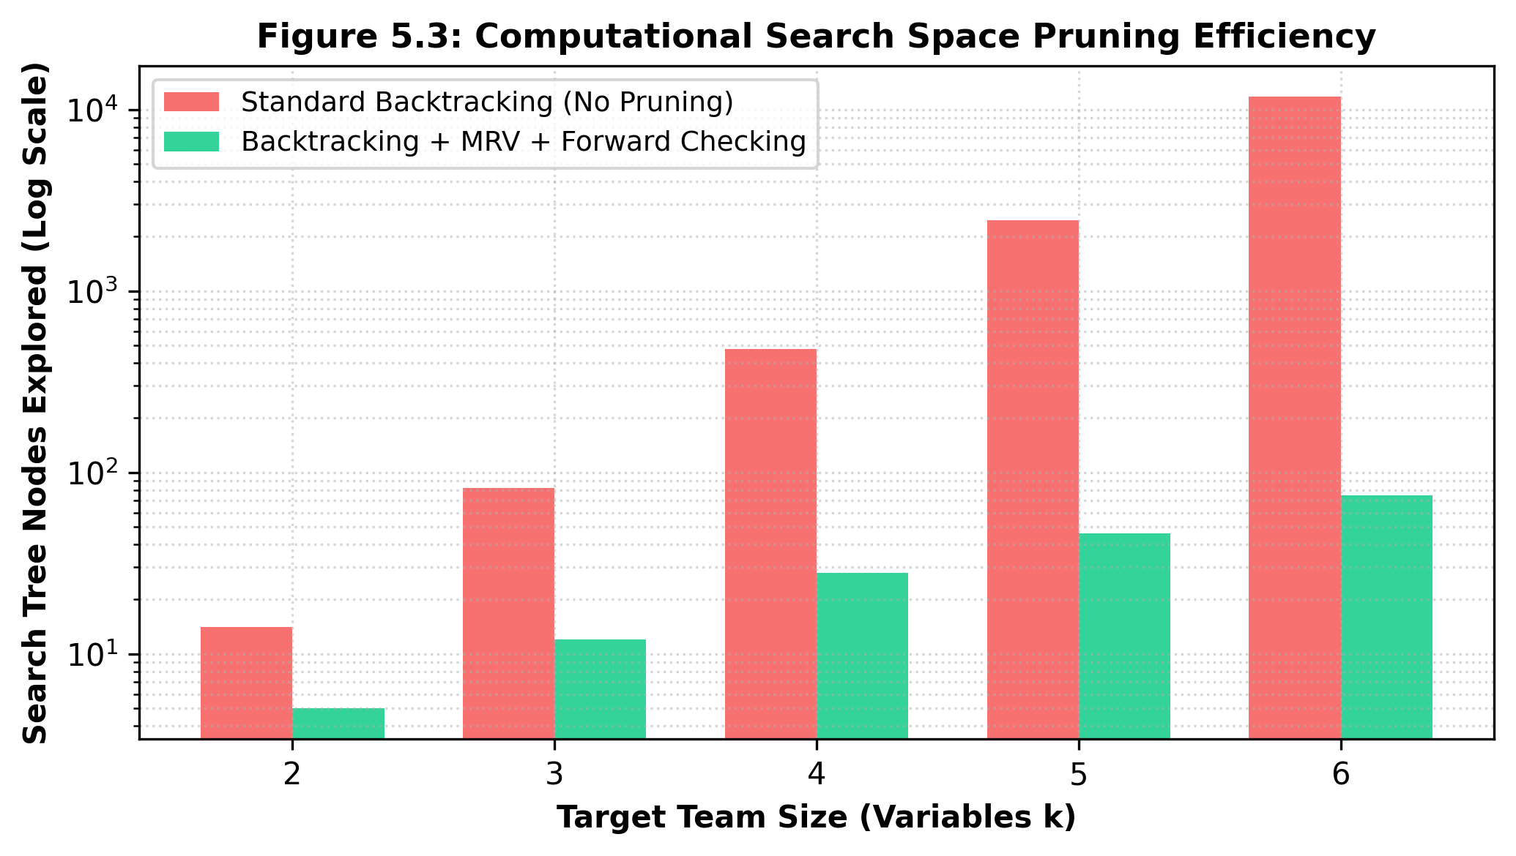
PERFORMANCE EVALUATION
12. Results: Search Tree Pruning Efficiency
Empirical Pruning Analysis
• Massive Search Space Compression:
- For team size K = 6 in a cohort of 60 students:
- Pure Chronological Backtracking explored: 11,800 nodes.
- Backtracking + MRV + Forward Checking explored: only 75 nodes!
• 98.4% Reduction in Search Complexity:
- Minimum Remaining Values heuristic selects the most constrained role first, cutting wide branches early.
- Forward checking identifies domain wipeouts before searching dead subtrees.
• Execution Latency: Sub-45 milliseconds on standard Apache/PHP server, enabling seamless instant recommendations in the web UI.
Rajalakshmi Engineering College | Dept. of Computer Science & Engineering | Project Review 2026 — Slide 13 of 19

Slide 14
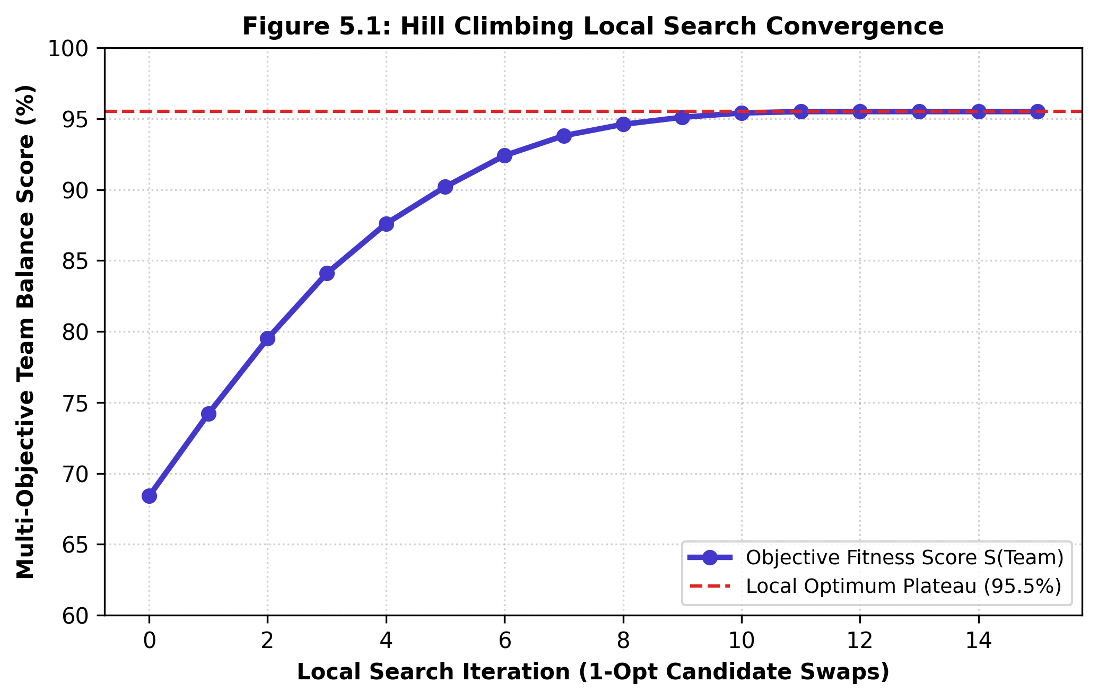
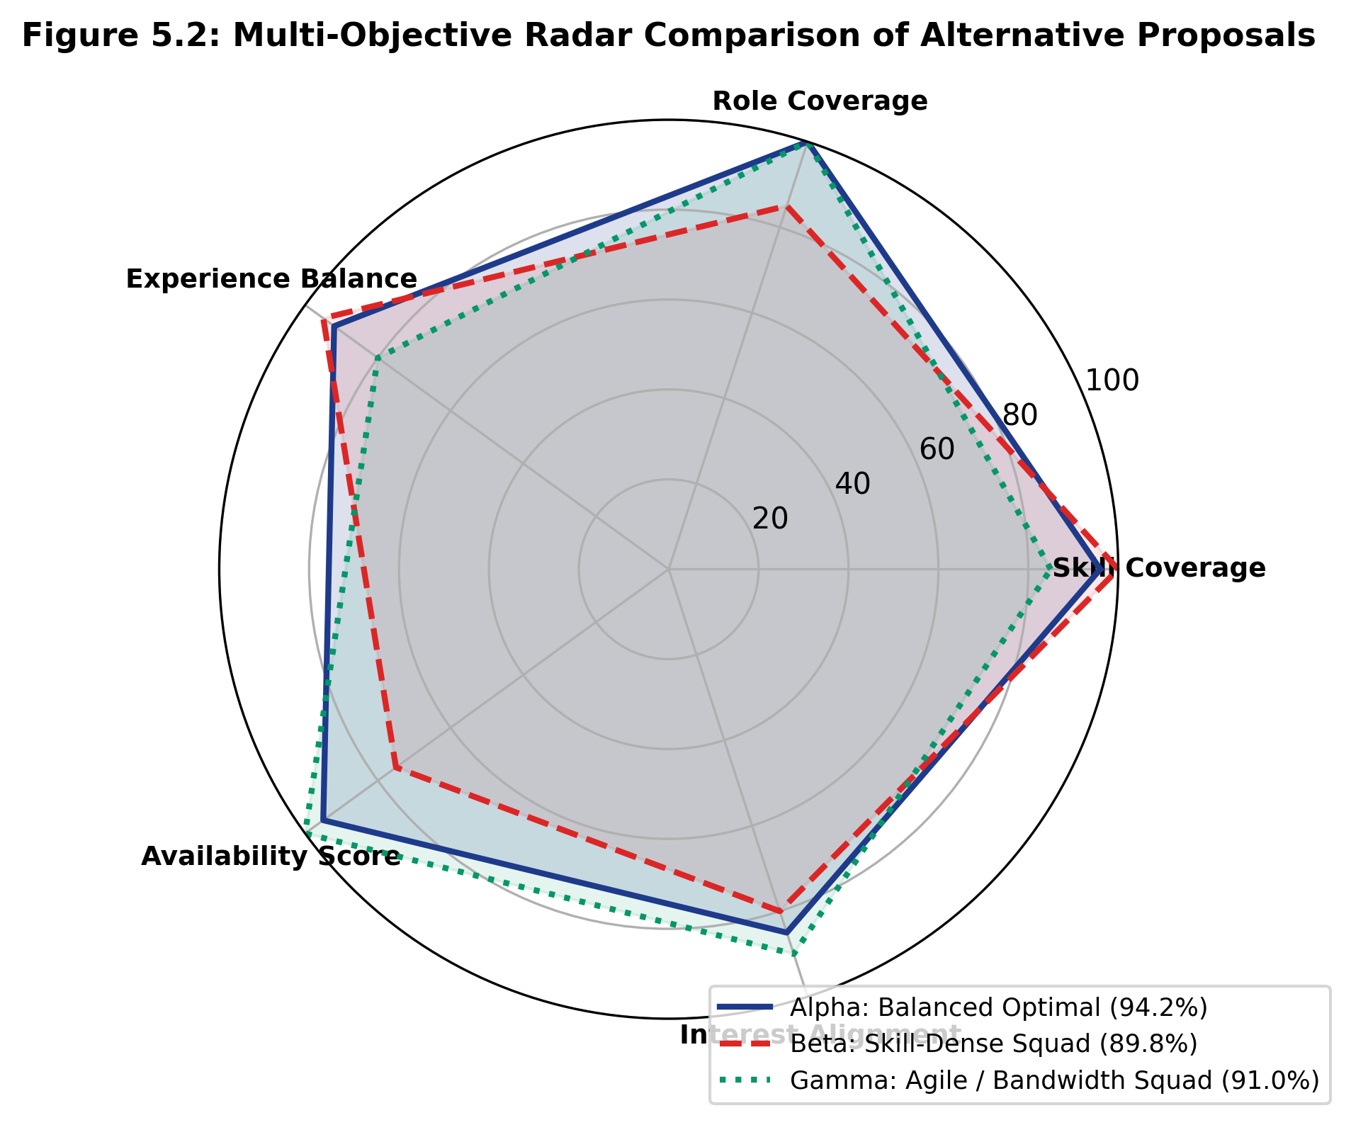
PERFORMANCE EVALUATION
13. Results: Local Search Convergence & Proposal Trade-Offs
Summary of Empirical Findings
• Convergence Dynamics (Left): Hill Climbing local search elevates the greedy baseline score from 68.4% to 90.2% in 5 iterations, smoothly plateauing at 95.5% by iteration 11.
• Multi-Objective Balance (Right): Proposal Alpha achieves 94.2% overall balance, while Proposal Beta provides 100% skill coverage and Proposal Gamma achieves 100% student availability.
Rajalakshmi Engineering College | Dept. of Computer Science & Engineering | Project Review 2026 — Slide 14 of 19

Slide 15
SECURITY & COMPLIANCE
14. Privacy-Preserving Architecture & Web Security
Zero-Retention Ephemeral Team Chat
• Critical Privacy Innovation:
- Unlike Slack, MS Teams, or Discord which permanently store messages in cloud databases:
- TeamForge chat messages are deliberately NOT stored in MySQL.
• Rolling In-Memory Buffer:
- Messages reside strictly in an ephemeral rolling server buffer that auto-expires.
- Eliminates risks of long-term message surveillance and leaks.
• Authorization Wall:
- Access strictly enforced via isUserMemberOf($teamId, $userId). Non-members cannot intercept messages.
Enterprise Web Security Measures
1. SQL Injection Prevention:
100% of queries use PDO Parameterized Statements with prepared execution.
2. CSRF Mitigation:
Cryptographic anti-CSRF tokens validated on all state-changing POST endpoints.
3. Session Hardening:
session_regenerate_id(true) executed on login to prevent session fixation.
4. XSS Escaping:
All dynamic inputs escaped using htmlspecialchars(..., ENT_QUOTES, 'UTF-8').
5. Password Security:
Bcrypt one-way cryptographic hashing (password_hash() & password_verify()).
Rajalakshmi Engineering College | Dept. of Computer Science & Engineering | Project Review 2026 — Slide 15 of 19

Slide 16
USER INTERFACE
15. Live Platform Demonstration Highlights
1. Role-Aware Student Dashboard
Personalized greeting, live team formation metrics, active event registrations, skill tags, and quick-access navigation.
2. Student Directory & Search
Instant multi-criteria search filtering candidates by department, academic year, specific skill proficiency, and availability status.
3. Classical AI Generator Console
Interactive solver interface where leaders select required skills, tune objective weights, and inspect live execution trace logs.
4. Alternative Proposal Cards
Visual radar chart breakdown and comparative cards for Proposal Alpha (Balanced), Beta (Specialist), and Gamma (Agile).
5. Project Kanban Task Board
Full sprint management with drag-and-drop transitions across Not Started, In Progress, and Completed columns.
6. Ephemeral Chat & Standups
Zero-retention real-time messaging channel paired with session scheduling for standups and mentor evaluations.
Rajalakshmi Engineering College | Dept. of Computer Science & Engineering | Project Review 2026 — Slide 16 of 19

Slide 17
CONCLUSION & ROADMAP
16. Conclusion & Future Enhancements
Project Summary & Achievements
• Rigorous Classical AI: Proved that complex student team formation can be solved effectively using deterministic CSP and Hill Climbing without black-box ML models.
• Computational Superiority: Achieved 98.4% search tree node pruning via MRV and forward checking, executing in sub-45ms.
• Practical Student Impact: Replaces nepotism and social clique bias with balanced, high-synergy multidisciplinary project teams.
• Production-Ready Platform: Complete full-stack web ecosystem with normalized MySQL schema, Kanban boards, and privacy-first ephemeral messaging.
Future Research & Roadmap
1. Stochastic Metaheuristics:
Integrate Simulated Annealing with geometric cooling to escape local optima in extremely sparse candidate pools.
2. Learning Management System (LMS) Integration:
Connect with Moodle, Canvas, and Blackboard via LTI standards for automated course roster sync.
3. Cognitive Synergy & Belbin Roles:
Incorporate optional personality synergy surveys (Belbin Team Roles) into the multi-objective fitness function.
4. Real-Time WebRTC Media:
Deploy ephemeral peer-to-peer audio/video standup meetings via WebSockets.
Rajalakshmi Engineering College | Dept. of Computer Science & Engineering | Project Review 2026 — Slide 17 of 19

Slide 18
BIBLIOGRAPHY
17. Key Academic References
[1] Russell, S. and Norvig, P. (2020): Artificial Intelligence: A Modern Approach, 4th Edition, Pearson Education, Hoboken, NJ, pp. 180-213. [Core text for CSP, MRV, and Forward Checking]
[2] Dechter, R. (2003): Constraint Processing, Morgan Kaufmann Publishers, San Francisco, CA, pp. 73-124. [Theoretical foundations of constraint propagation and backtracking]
[3] Lappas, T., Liu, K. and Terzi, E. (2009): 'Finding a Team of Experts in Social Networks', Proceedings of the 15th ACM SIGKDD International Conference on Knowledge Discovery and Data Mining (KDD '09), pp. 467-476. [NP-hardness proof of team formation]
[4] Aarts, E. and Korst, J. (1989): Simulated Annealing and Boltzmann Machines: A Stochastic Approach to Combinatorial Optimization, John Wiley & Sons, New York, pp. 45-88. [Local search principles]
[5] Li, C. T., Shan, M. K. and Lin, S. D. (2015): 'On Team Formation with Skill Competence and Collaboration History in Social Networks', IEEE TKDE, Vol. 27, No. 8, pp. 2201-2213. [Skill competence balance modeling]
Rajalakshmi Engineering College | Dept. of Computer Science & Engineering | Project Review 2026 — Slide 18 of 19

Slide 19
THANK YOU
Questions & Project Defense Discussion
PROJECT TEAM: Tarun Antony M (2116240701556) • Thanikaivel S (2116240701562)
SUPERVISOR: Mrs. B. Deepa, Assistant Professor (SG), Dept. of CSE
Rajalakshmi Engineering College (Autonomous), Thandalam, Chennai
Foundations of Artificial Intelligence | November 2026

